Slide 1
THE CENTRALITY OF VALUING
PHILIP KITCHER

Slide 2
MELIORATIVE PROJECTS
AT THE HEART OF DEWEY’S PRAGMATISM IS THE CONVICTION THAT INQUIRY IS DIRECTED TOWARD MAKING THINGS BETTER.
TO UNDERSTAND THAT GOAL, WE NEED AN ACCOUNT OF VALUES.
HENCE, THE THEORY OF VALUE (S?) IS CENTRAL TO DEWEYAN PRAGMATISM.

Slide 3
UNFINISHED BUSINESS
BUT, FOR ALL THAT DEWEY WRITES ABOUT VALUES IN MANY PLACES (HNC, TV, E, PLUS SECTIONS OF EN AND QC), THERE IS NO WELL-ARTICULATED THEORY OF VALUE IN HIS WRITINGS.
ONE MAJOR CLUE: VALUE DEPENDS ON VALUING.
HENCE THE THEORY OF VALUING IS CENTRAL.
WHAT IS VALUING? HOW DO WE DO IT WELL?

Slide 4
THEMES IN PRAGMATIST ETHICS
NO INVOCATION OF MYSTERIOUS “ETHICAL REALITY”
NO A PRIORI DISCLOSURE OF ETHICAL TRUTH
ETHICS IS PERMANENTLY UNFINISHED
“TRUTH HAPPENS TO AN IDEA” (JAMES)
“MORAL CONCEPTIONS GROW NATURALLY OUT OF THE VERY CONDITIONS OF HUMAN LIFE” (DEWEY)

Slide 5
PROPOSAL
UNDERSTAND VALUING BY CONSIDERING HOW HUMAN BEINGS CAME TO DO IT, AND HOW THEY AMEND THEIR WAYS OF DOING IT.
START FROM THE “CONDITIONS OF HUMAN LIFE”.
DEWEY IDENTIFIES THESE AS CONSISTING OF SOCIALITY AND INDIVIDUAL DESIRE.

Slide 6
THE LIVES OF PRE-ETHICAL HUMANS (HOMINIDS)
PROBABLY AKIN TO THOSE OF CONTEMPORARY CHIMPANZEES (SMALL GROUPS MIXED BY AGE AND SEX).
THIS FORM OF SOCIAL LIFE REQUIRES A CAPACITY FOR PSYCHOLOGICAL ALTRUISM (THE ABILITY TO IDENTIFY AND RESPOND TO THE DESIRES OF OTHERS).
IN CONTEMPORARY CHIMPS (AND PROBABLY AMONG OUR ANCESTORS) THIS CAPACITY WAS LIMITED. IN CONSEQUENCE, COOPERATIVE BEHAVIOR WAS LIMITED TOO.

Slide 7
NORMATIVE GUIDANCE
THE WAY OUT
A NEW ABILITY TO IDENTIFY PROBLEMATIC BEHAVIOR IN ADVANCE, AND TO CHECK IMPULSES
THE ABILITY TO REFLECT ON THAT FORM OF BEHAVIOR
AND TO DISCUSS IT WITH OTHERS
RESULT – A SOCIAL ACTIVITY IN WHICH RULES FOR LIVING TOGETHER ARE FASHIONED (ALSO: METHODS OF ENFORCEMENT, INSPIRING STORIES)

Slide 8
AN EVOLVING ETHICAL AGENT
THE “MORAL POINT OF VIEW” IS A MYTH.
DEVICES OF ETHICAL MOTIVATION EVOLVE – A WELL-BUFFERED SYSTEM.
VIRTUOUS CYCLES:
RULES/STORIES → MORE COOPERATION → REFINED SYMPATHY
↑ ↓
NEW RULES/STORIES ← REFLECTION AND DISCUSSION

Slide 9
EMERGENT FEATURES OF ETHICAL LIFE
DIVISIONS OF LABOR
ROLES AND INSTITUTIONS
HIGHER-ORDER ALTRUISM
A RICHER CONCEPTION OF THE GOOD LIFE

Slide 10
INTERFERENCE
SOME OF THESE INTERFERE WITH THE INITIAL CONDITIONS OF THE ETHICAL LIFE.
EQUALITY PERTURBED BY DIFFERENTIATION OF ROLES.
JOINT DISCUSSION PERTURBED BY THE IDEA OF ETHICAL EXPERTS (THOSE WITH ACCESS TO THE WILL OF THE TRANSCENDENT POLICEMAN).

Slide 11
5000 YEARS AGO
COMPLEX SETS OF RULES AMONG THE FIRST DOCUMENTS.
THIS IS A REFLECTION OF A PROCESS THAT HAS OCCURRED FOR TENS OF THOUSANDS OF YEARS.
ORIGINALLY IN EGALITARIAN DISCUSSIONS IN SMALL GROUPS.
BUT, FOR THE PREVIOUS 5000 YEARS (FROM 10,000 YBP ON) IN INCREASINGLY DIFFERENTIATED AND HIERARCHICAL SOCIETIES.

Slide 12
THE HISTORICAL RECORD
SINCE THEN, WE CAN SOMETIMES OBSERVE ETHICAL CHANGE.
SOME EPISODES SEEM TO SHOW PROGRESS.
EXAMPLE:
FROM: IF A MAN KILLS THE CHILD OF ANOTHER MAN, THAT MAN’S CHILD SHALL BE PUT TO DEATH
TO: IF A MAN KILLS SOMEONE ELSE, HE SHALL BE PUT TO DEATH.

Slide 13
MORE EXAMPLES
ABOLITION OF SLAVERY
INCREASED OPPORTUNITIES FOR WOMEN
RELAXATION OF SEXUAL TABOOS

Slide 14
CAN WE MAKE SENSE OF PROGRESS?
NOT IF WE THINK OF ETHICAL PROGRESS AS THE DISCOVERY OF PRIOR ETHICAL TRUTH.
NO IDENTIFIABLE EPISODES OF APPREHENDING A NEW TRUTH.
SO THINK OF PROGRESS AS THE PRIOR CONCEPT.
“TRUTH HAPPENS TO AN IDEA”.

Slide 15
ETHICS AS SOCIAL TECHNOLOGY
PROGRESS IN TECHNOLOGY AS PROBLEM-SOLVING.
THE INTRODUCTION OF DEVICES TO FULFILL FUNCTIONS.
FUNCTIONS AS DETERMINED BY THE PROBLEM BACKGROUND.
THE ORIGINAL FUNCTION: REMEDYING ALTRUISM FAILURES.

Slide 16
FUNCTIONAL CONFLICT
SATISFYING SOME FUNCTIONS GENERATES OTHERS
EXAMPLE: TRANSPORTATION NEEDS NOT ONLY VEHICLES BUT A HOST OF SUPPORTING SYSTEMS.
FUNCTIONS CAN CONFLICT. SATISFYING SOME FUNCTIONS MAY INTERFERE WITH FINDING GOOD SOLUTIONS FOR OTHER PROBLEMS.
FUNCTIONAL CONFLICT LIES AT THE HEART OF THE DIFFICULTIES, NOT ONLY WITH ETHICS BUT WITH THE GENERAL THEORY OF VALUE.

Slide 17
ETHICAL TRUTH
RULES HAVE DESCRIPTIVE COUNTERPARTS
“TELL THE TRUTH!” – “HONESTY IS GOOD”
SUPPOSE A RULE HAS THE FOLLOWING PROPERTIES:
ADDING IT TO AN ETHICAL TRADITION THAT LACKS IT WOULD BE PROGRESSIVE
IT WOULD ALWAYS BE RETAINED IN FURTHER PROGRESSIVE TRADITIONS.
THEN ITS DESCRIPTIVE COUNTERPART IS TRUE.
AN ETHICAL STATEMENT IS FALSE JUST IN CASE ITS NEGATION IS TRUE.

Slide 18
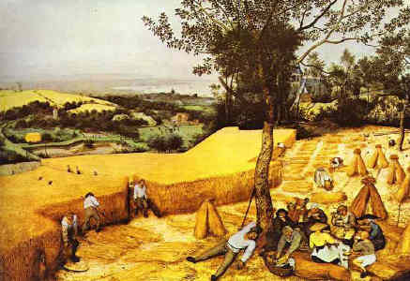
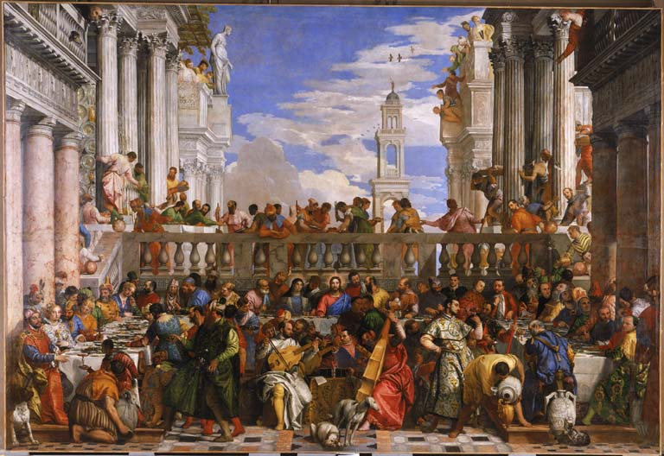
OUTCOMES OF ETHICAL TRADITIONS THAT EMPHASIZE DIFFERENT FUNCTIONS

Slide 19
ETHICAL PLURALISM
THERE ARE PROBABLY SOME ETHICAL TRUTHS (CORRESPONDING TO “MOTHER’S BEST ADVICE”).
THERE ARE PROBABLY SOME TRADITIONS THAT EMPHASIZE DIFFERENT FUNCTIONS AND THAT WOULD PROGRESS INDEFINITELY WITHOUT EVER CONVERGING.
SO (PROBABLY) SOME ETHICAL STATEMENTS LACK TRUTH VALUES.

Slide 20
A GENERAL THEORY OF VALUING
WHEN ETHICAL TRADITIONS MAKE PROGRESS BY COMMENDING PARTICULAR CHARACTERISTICS OR PARTICULAR GOALS, WE SHOULD COUNT THEM AS IDENTIFYING GENUINE VALUES.
THESE VALUES STEM FROM THE PROCESSES THAT UNDERLIE THE COMMENDATION: VALUE COMES FROM VALUING.

Slide 21
THE PROJECT IS INESCAPABLE
THE ETHICAL PROJECT HAS GIVEN US THE ROLES AND INSTITUTIONS THAT CURRENTLY SHAPE OUR LIVES, THE VALUES WE TAKE TO BE IMPORTANT, AND OUR CONCEPTION OF OURSELVES AND OF OUR LIVES.
THE ONLY ALTERNATIVE TO CONTINUING IT WOULD BE A RETURN TO THE UNREGULATED SOCIAL LIVES OF OUR REMOTE ANCESTORS.

Slide 22
HOW TO GO ON?
YET THERE ARE SERIOUS QUESTIONS ABOUT HOW TO GO ON.
THESE RESULT FROM FUNCTIONAL CONFLICTS.
WHICH FUNCTIONS SHOULD OUR PRESENT ACTS OF VALUING NOW ENDORSE?

Slide 23
THE LIMITS OF PHILOSOPHY
ONCE WE ABANDON THE IDEA OF A PRIOR WORLD OF VALUES, AN EXTERNAL SOURCE OF ETHICAL CONSTRAINT, THE FURTHER DEVELOPMENT OF THE PROJECT CAN ONLY BE A MATTER FOR JOINT DECISION.
THERE ARE NO EXPERTS WITH FINAL AUTHORITY.
PHILOSOPHY’S ROLE IS TO FACILITATE THE CONVERSATION.

Slide 24
TWO PROPOSALS
AN EGALITARIAN IDEAL
AIM TO PROVIDE FOR ALL HUMAN BEINGS SERIOUS (AND ROUGHLY EQUAL) OPPORTUNITIES FOR A WORTHWHILE LIFE.
A SUGGESTED METHOD
ETHICAL DECISIONS SHOULD BE THOSE THAT WOULD RESULT FROM IDEAL CONVERSATIONS, DISCUSSIONS IN WHICH ALL WELL-INFORMED PERSPECTIVES WERE REPRESENTED AND IN WHICH DISCUSSANTS AIMED TO SATISFY THE ASPIRATIONS OF ALL.

Slide 25
FEATURES OF THESE PROPOSALS
UNLIKE SOME ALTERNATIVES, THESE ARE COHERENT.
THEY ENDORSE THE ORIGINAL FUNCTION OF ETHICS (REMEDYING ALTRUISM FAILURES).
CONJECTURE: IT IS IMPOSSIBLE TO CONTINUE THE PROJECT, TO OVERRIDE THE ORIGINAL FUNCTION AND TO ACHIEVE THE SAME COHERENCE BETWEEN IDEAL AND METHOD.

Slide 26
WHY THIS IS PRAGMATISM
VALUATION IS SEEN AS GROWING OUT OF THE HUMAN PREDICAMENT.
TRUTHS ABOUT VALUES INVOLVE A PRAGMATIC CONCEPTION OF TRUTH.
NO INVOCATION OF “EXTERNAL VALUE REALITY”.
NO “A PRIORI DISCLOSURES”.
VALUATION IS PERMANENTLY UNFINISHED.

Slide 27
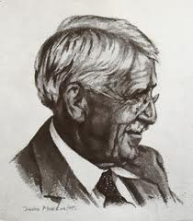
CONCLUSION
THIS APPROACH TO VALUES COMPLETES DEWEY’S “UNFINISHED BUSINESS”.

