Slide 1
TRANSFORMING EPISTEMOLOGY
PHILIP KITCHER

Slide 2
A MELIORATIVE VENTURE
PHILOSOPHICAL REFLECTIONS ON KNOWLEDGE HAVE THE GOAL OF MAKING INQUIRY GO BETTER.
WHAT DOES IT MEAN FOR INQUIRY TO GO BETTER?

Slide 3
A SEVENTEENTH CENTURY VERSION
“WE MUST AVOID THE CATASTROPHE OF THE PAST TWO MILLENNIA.”
“HUMAN KNOWLEDGE HAS BEEN BUILT ON UNCERTAIN FOUNDATIONS.”
REMEDY: THE QUEST FOR CERTAINTY

Slide 4
AFTER FALLIBILISM
THERE ARE NO ABSOLUTELY CERTAIN FOUNDATIONS.
WE HAVE LEARNED TO LIVE WITH RIGOROUS REVISION OF KNOWLEDGE.
HOW TO REVISE BELIEFS?

Slide 5
INDIVIDUALISM AND ITS LIMITS
METHODOLOGY AS FOCUSED ON THE RATIONAL AGENT.
WHAT TRANSITIONS OF THE FORM
K → K*
E
ARE JUSTIFIABLE?

Slide 6
A BETTER VERSION
FOCUS ON TRANSITIONS OF THE FORM
<K,V> → <K*,V*>
E

Slide 7
METHODOLOGICAL PROPOSAL
SET THIS UP IN TERMS OF PROBABILITIES, AND USE BAYESIAN CONDITIONALIZATION.
PROBLEMS: TYPICALLY, ALTHOUGH NOT ALWAYS, THE PROBABILITIES ARE UNDEFINED.

Slide 8
EXAMPLE
LET F BE FRESNEL’S WAVE HYPOTHESIS, E BE THE OBSERVATION OF THE BRIGHT SPOT.
PR(F|E) = PR(F).PR(E|F) / PR(E)
PR(E) = PR(F).PR(E|F) + PR(~F).PR(E|~F)
BUT WHAT IS PR(E|~F) ?

Slide 9
DIVERSITY OF THE SCIENCES
PHILOSOPHY CAN GIVE US A “THIN”, GENERAL METHODOLOGY.
THESE DAYS, THE SUBSTANTIVE DETAILS ARE WORKED OUT, IN DIFFERENT WAYS, IN THE SUCCESSFUL SCIENCES.

Slide 10
POST-KUHNIAN CHALLENGES
LAVOISIER’S ACHIEVEMENT.
ELABORATION OF ALTERNATIVE ACCOUNTS OF CHEMICAL REACTIONS.
WHICH ARE THE IMPORTANT PROBLEMS?
WHEN HAS ENOUGH BEEN DONE?

Slide 11
CONCLUSION FROM THESE THREE DIFFICULTIES
THE RESIDUAL TASK OF METHODOLOGY, AS TRADITIONALLY CONCEIVED, LIES IN EXPOSING THE REASONABLENESS OF CERTAIN TRANSITIONS.
PHILOSOPHY WORKS WITH A MIX OF TOOLS, SOME DRAWN FROM THE METHODOLOGICAL TRADITION, SOME FROM THE AREA OF INQUIRY UNDER STUDY.
THIS IS THOROUGHLY PRAGMATIC.

Slide 12
ARE THERE OTHER EPISTEMOLOGICAL PROJECTS?
NOT: MANY TRADITIONAL FORMS OF SKEPTICISM, ANALYSES OF ‘S KNOWS THAT p’, INTERNALISM, FOUNDATIONALISM, ETC. ETC.
BUT: ISSUES ABOUT GOALS – AND ABOUT INQUIRY AS A COLLECTIVE ENTERPRISE.

Slide 13
TRUTH
ONE OBVIOUS SUGGESTION ABOUT GOALS: INDIVIDUAL BELIEF SYSTEMS SHOULD BE MODIFIED SO AS TO BE CLOSER TO THE TRUTH.
SHOULD PRAGMATISTS USE THIS TYPE OF LANGUAGE?

Slide 14
RELUCTANCE
MANY PRAGMSTISTS, OLD AND NEW, HAVE BEEN WORRIED ABOUT TALK OF TRUTH – PARTICULARLY ABOUT CORRESPONDENCE TRUTH.
PRAGMATISTS SHOULD ALSO ADMIT THAT TALK OF TRUTH MAY GO DIFFERENTLY IN DIFFERENT DOMAINS (ETHICS, MATHEMATICS).

Slide 15
BUT …
ABSTINENCE FROM TALK OF TRUTH LEAVES PRAGMATISM TOO CLOSE TO IDEALISM AND/OR CONSTRUCTIVISM.
JAMES AND DEWEY OPPOSED BAD (PRE-TARSKIAN) THEORIES OF TRUTH.
AFTER TARSKI, WE CAN RECLAIM JAMES’ “ORDINARY CONCEPTION”.

Slide 16
NEVERTHELESS …
TRUTH IS NOT THE GOAL OF INQUIRY.
HUMAN BEINGS ARE FINITE – THE WHOLE TRUTH IS AN IMPOSSIBLE DREAM.
WHAT WE AIM AT IS SIGNIFICANT TRUTH.
OR SIGNIFICANT STATEMENTS CLOSE ENOUGH TO THE TRUTH FOR OUR PURPOSES.

Slide 17
IN WHAT LANGUAGE?
CLASSICAL PRAGMATISTS RIGHTLY INSISTED ON THE PLURALITY OF WAYS OF CONCEPTUALIZING REALITY (= THAT WHICH IS INDEPENDENT OF US).
THE WORLD OF OBJECTS (IN WHICH WE LIVE) IS FORMED IN PART BY THE BOUNDARIES WE DRAW.
THESE, TOO, ARE SHAPED BY OUR CAPACITIES AND EVOLVING PROJECTS.

Slide 18
THE COLLECTIVE DIMENSION OF SIGNIFICANCE
A QUESTION IS SIGNIFICANT IF IT WOULD BE ENDORSED IN AN IDEAL DISCUSSION.
IDEAL DISCUSSIONS INVOLVE:
FULL REPRESENTATION OF PERSPECTIVES
TUTORING OF PERSPECTIVES TO REMOVE IDENTIFIABLE ERRORS
MUTUAL ENGAGEMENT

Slide 19
THE COLLECTIVE IDEAL
COLLECTIVE INQUIRY AIMS AT
A STATE IN WHICH SIGNIFICANT QUESTIONS ARE ANSWERED
WHERE THE ANSWERS ARE TRUE – OR TRUE ENOUGH TO SUIT THE PURPOSES OF THOSE WHO NEED THEM
AND WHERE THE ANSWERS ARE AVAILABLE TO THOSE WHO NEED THEM.

Slide 20
COLLECTIVE METHODOLOGY
AIMS AT IDENTIFYING RELIABLE METHODS FOR ANSWERING SIGNIFICANT QUESTIONS.
HOW SHOULD COLLECTIVE INQUIRY BE PURSUED TO MAKE IT AS RELIABLE AND AS EFFICIENT AS POSSIBLE?

Slide 21
BEYOND THAT …
THE COLLECTIVE IDEAL DEMANDS ATTENTION TO:
FOCUSING ON SIGNIFICANT QUESTIONS
TRANSMITTING THE ANSWERS.

Slide 22
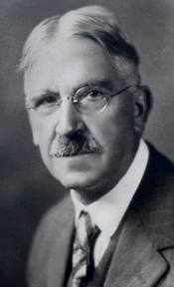
A DEWEYAN THEME
THE MEANING OF SCIENCE, IN TERMS OF KNOWLEDGE OF THE ACTUAL, MAY WELL BE LEFT TO SCIENCE ITSELF. ITS MEANING IN TERMS OF THE GREAT HUMAN USES TO WHICH IT MAY BE PUT, ITS MEANING IN THE SERVICE OF POSSIBILITIES OF SECURE VALUE, OFFERS A FIELD FOR EXPLORATION WHICH CRIES OUT FROM VERY EMPTINESS. (QC 248)

Slide 23
SOCIAL EPISTEMOLOGY I: WITHIN INQUIRY
DIVISION OF EFFORT WITHIN A RESEARCH COMMUNITY
DIVISION OF STRATEGY
DIVISION OF ROLE
COOPERATION

Slide 24
THE DIVISION OF COGNITIVE LABOR
THIS OBTAINS WITHIN AN AREA OF RESEARCH
IN THE ATTEMPT TO SOLVE PROBLEMS DIVERSITY OF APPROACHES IS OFTEN VALUABLE.
AS A MATTER OF PSYCHOLOGICAL FACT, DIVERSITY OF APPROACHES MAY PRESUPPOSE DIFFERENCES OF OPINION – DISSENT.

Slide 25
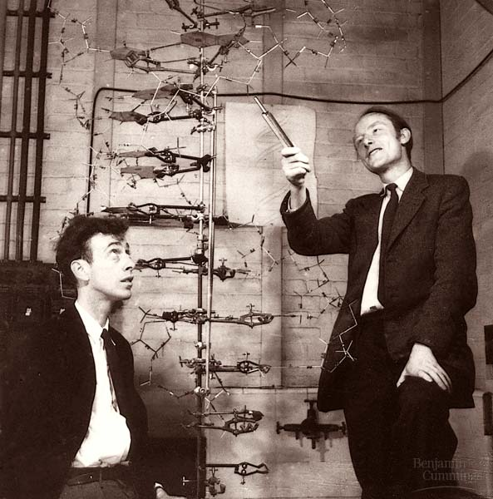
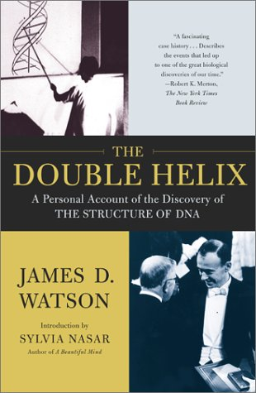
IN PRACTICE, VALUABLE DIVISION OF LABOR IS OFTEN OBTAINED THROUGH COMPETITION AND THE SEARCH FOR CREDIT.
Competition and the search for credit.

Slide 26
A SIMPLE MODEL
TWO METHODS AVAILABLE.
ASSUMING AT LEAST ONE PERSON WORKS ON A METHOD (M_{i}), THE CHANCE THAT THAT METHOD WILL SUCCEED IS SOME NUMBER p_{i}.
IF ONE METHOD SUCCEEDS, THE OTHER DOESN’T.
p₁ > p₂ > 0
IF EACH METHOD HAS SOMEONE WORKING ON IT, THE COMMUNITY CHANCE OF SUCCESS IS
p₁ + p₂ (WHICH IS GREATER THAN p₁ )
DIVERSITY IS GOOD FOR THE COMMUNITY (THOUGH NOT, APPARENTLY, FOR THOSE WHO PURSUE M₂)

Slide 27
THE CREDIT ECONOMY

Slide 28
CONFORMISTS AND MAVERICKS
A SIMILAR MODEL WORKS FOR CONFORMISTS AND MAVERICKS.
CONFORMISTS WORK WITHIN THE TRADITIONAL FRAMEWORK; MAVERICKS FLOUT THE USUAL RULES.
MOST MAVERICKS WILL BE DISMISSED AS CRANKS (OR WORSE), BUT A MINUTE FRACTION OF THEM WILL TRANSFORM THE FIELD.
THE WINNINGS FOR MAVERICKS ARE MUCH HIGHER THAN THOSE FOR CONFORMISTS, BUT THEIR CHANCES OF WINNING ARE LOW.

Slide 29
DOWNSIDES OF THE CREDIT ECONOMY
RELUCTANCE TO SHARE FINDINGS WITH OTHERS.
TEMPTATION TO CUT CORNERS (DRY-LABBING, PLAGIARISM, MISREPRESENTATION, FRAUD)
SEEKING PUBLIC CREDIT WHEN PROFESSIONAL CREDIT FAILS.

Slide 30
SOCIAL EPISTEMOLOGY II: THE INTERFACE
TWO PROBLEMS
HOW TO FOCUS INQUIRY ON THE RIGHT ISSUES?
HOW TO TRANSMIT KNOWLEDGE FOR PUBLIC USE?

Slide 31
INADEQUACIES OF THE MARKET
IT IS OPTIMISTIC TO THINK THAT RESEARCHERS WILL ALWAYS GRAVITATE TO THE MOST CRITICAL INQUIRIES.
IT IS EVEN MORE OPTIMISTIC TO SUPPOSE THAT MARKET MECHANISMS IN THE BROADER ECONOMY WILL DO THE TRICK.

Slide 32
PURSUIT
THE RESEARCH AGENDA WOULD BE ACCEPTED IN AN IDEAL CONVERSATION
EXAMPLE: DISEASE RESEARCH
THE FAIR-SHARE PRINCIPLE: ASSIGN RESOURCES TO EACH DISEASE IN PROPORTION TO THE BURDEN IT INFLICTS

Slide 34
FAULTY TRANSMISSION
GLOBAL WARMING
GENETICALLY MODIFIED ORGANISMS
IN CASES LIKE THESE, PUBLIC DEBATES DO NOT START IN THE RIGHT PLACES.

Slide 35
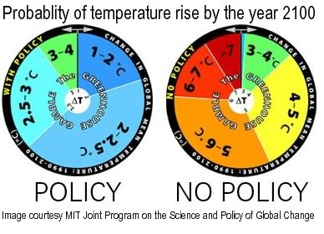
ANTHROPOGENIC GLOBAL WARMING IS UNCONTROVERSIAL.
CLIMATE SCIENTISTS TRY TO ESTIMATE THE PROBABILITIES OF THE SIZE OF THE INCREASE.

Slide 36
CONCLUSION
FOR A DEWEYAN PRAGMATIST, THE HEIRS OF THE CLASSICAL EPISTEMOLOGICAL PROBLEMS STEM FROM THE TWO TYPES OF SOCIAL EPISTEMOLOGY.
HOW SHOULD INQUIRY BE ORGANIZED – INTERNALLY AND IN RELATION TO WIDER HUMAN GOALS?

