Slide 1
CHALLENGES TO DEMOCRACY
PHILIP KITCHER

Slide 2
DEWEY’S CONCERNS
IN COMPLEX SOCIETIES, THERE IS A LOSS OF COMMUNITY – AND THIS IS DETRIMENTAL TO THE HEALTH OF ANY DEMOCRACY.
THE ECONOMIC PRESSURES OF COMPLEX SOCIETIES DISTORT THE FUNCTION OF EDUCATION, AND THEREBY UNDERMINE DEMOCRATIC VALUES AND INSTITUTIONS.

Slide 3
WHY IS THIS?
THERE IS NO APPARENT THREAT TO ELECTIONS, OR TO FREE DISCUSSION, EVEN IF A SOCIETY IS LARGE AND COMPLEX.
DEWEY’S CONCERNS REST ON THE THOUGHT THAT ELECTIONS UNDER CONDITIONS OF OPEN DISCUSSION ARE ONLY A SMALL PART OF THE CONCEPT OF DEMOCRACY.

Slide 4
DEMOCRACY
ANY SATISFACTORY ACCOUNT OF DEMOCRACY SHOULD EXPLAIN ITS VIRTUES.
ELECTIONS AND FREE DISCUSSIONS ARE IMPORTANT BECAUSE THEY PROMOTE SOME MORE BASIC GOOD.
THEY ALLOW CITIZENS TO PLAY A ROLE IN DECISIONS THAT AFFECT THEIR LIVES – AND THEREBY ENHANCE THE CITIZENS’ FREEDOM.

Slide 5
VALUES AGAIN
RECALL THE EGALITARIAN IDEAL: SERIOUS CHANCES FOR ALL OF LIVING A WORTHWHILE LIFE.
ONE PART OF LIVING A WORTHWHILE LIFE CONSISTS IN ACHIEVING YOUR OWN SENSE OF DIRECTION.
MILL: PURSUING ONE’S OWN GOOD IN ONE’S OWN WAY.

Slide 6
DEMOCRACY AND EDUCATION
THIS EXPLAINS DEWEY’S WORRY ABOUT THE ECONOMIC PRESSURES ON EDUCATION.
HE IS CONCERNED THAT THE ECONOMIC STRUCTURES OF COMPLEX SOCIETIES UNDERMINE THE VALUE DEMOCRACY IS INTENDED TO PROMOTE.
(TO BE EXPLORED IN THE NEXT LECTURE).

Slide 7
LOSING THE PUBLIC
WHAT IS THE THREAT POSED BY LOSS OF COMMUNITY?
THIS STEMS FROM A SPECIFIC CONCEPTION OF THE WORTHWHILE LIFE.
WORTHWHILE LIVES INVOLVE INTERACTIONS WITH OTHERS – PARTICIPATION IN JOINT PROJECTS.

Slide 8
WORTHWHILE LIVES
FEATURES OF WORTHWHILE LIVES:
THEY ARE FREELY CHOSEN.
THEY INVOLVE JOINT PROJECTS.
THOSE PROJECTS ARE NOT BLOCKED BY THE EFFORTS OF OTHERS.
RECOGNITION OF ONESELF AS CONTRIBUTING TO THE JOINT PROJECTS.
?? RECOGNITION THAT OTHERS RECOGNIZE THE CONTRIBUTIONS.

Slide 9
DEWEY AND MILL
AGREE ON NONINTERFERENCE.
BUT DEWEY FRAMES THIS NOT IN TERMS OF INDIVIDUALS BUT OF GROUPS OF INTERACTING INDIVIDUALS.
BECAUSE HE BUILDS INTERRELATIONSHIPS INTO HIS CONCEPTION OF THE WORTHWHILE LIFE.

Slide 10
COMMON POINTS
REQUIREMENT OF A WIDE RANGE OF OPTIONS FOR GENUINE CHOICE (A CONSTRAINT ON EDUCATION).
REQUIREMENT OF GOOD SOURCES OF INFORMATION (A CONSTRAINT ON THE SYSTEM OF PUBLIC KNOWLEDGE).
THE IMPORTANCE OF SOCIAL EPISTEMOLOGY.

Slide 11
FAILURES IN TRANSMISSION
ONE TYPE OF PROBLEM OCCURS WHEN CITIZENS HAVE PREFERENCES THAT ARE AT ODDS WITH THEIR INTERESTS.
BECAUSE THEY LACK ACCESS TO “PUBLIC KNOWLEDGE”.
CLIMATE CHANGE AS A CONTEMPORARY EXAMPLE.

Slide 12
OPACITY
IN A COMPLEX SOCIETY, THE SITUATIONS AND ASPIRATIONS OF MANY OTHERS ARE INVISIBLE.
HENCE, IN PURSUING YOUR JOINT PROJECT WITH YOUR COLLEAGUES YOU FAIL TO SEE
HOW YOUR ACTIONS AFFECT OUTSIDERS
WHAT THOSE OUTSIDERS ARE TRYING TO DO.
LIKELY RESULTS: MUTUAL INTERFERENCE.

Slide 13
A WORK IN PROGRESS
DEMOCRACY IS A WORK IN PROGRESS.
HISTORICALLY, IT HAS EMERGED THROUGH PROCESSES IN WHICH A PARTICULAR TYPE OF PROBLEM WAS DOMINANT.
THE PROBLEM OF IDENTIFIABLE OPPRESSION.

Slide 14
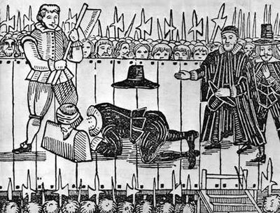
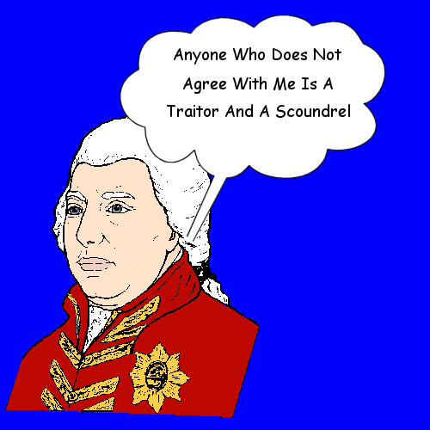
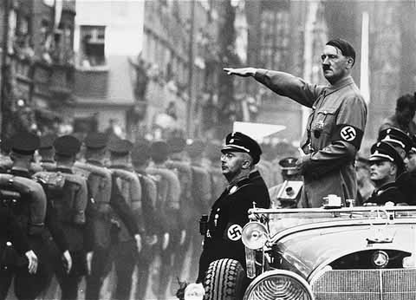
IDENTIFIABLE OPPRESSION IS TYPICALLY EMBODIED IN TYRANNICAL RULERS.
CONSTITUTIONS AND ELECTIONS OFFER SAFEGUARDS.

Slide 15
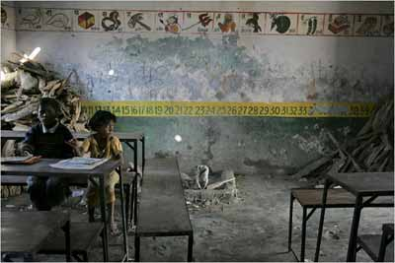
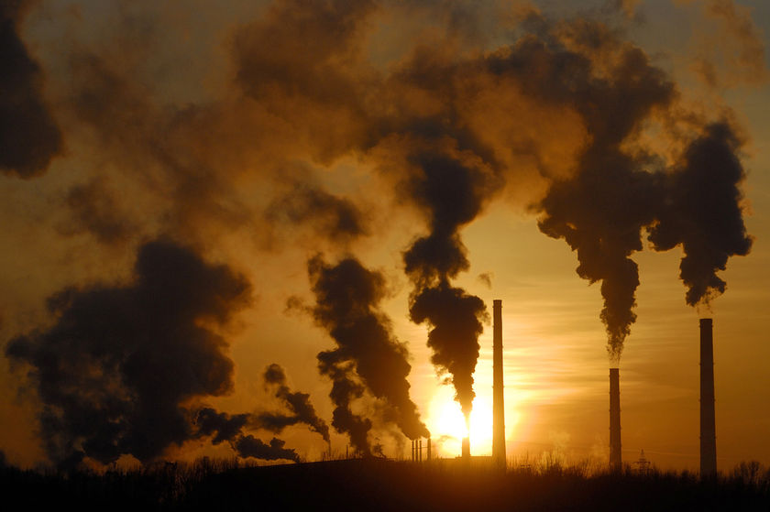
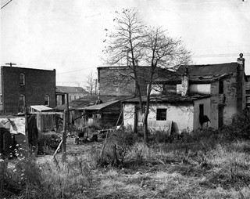
COMPLEX SOCIETIES FACE PROBLEMS OF UNIDENTIFIABLE OPPRESSION.
TRANSMISSION FAILURES AND OPACITY.

Slide 16
PROPOSAL
WE SHOULD THINK OF THESE SITUATIONS AS DIMINUTIONS OF FREEDOM.
THE FUNDAMENTAL FREEDOM IS TO CHOOSE AND TO PURSUE “ONE’S OWN GOOD IN ONE’S OWN WAY”.
THAT IS COMPROMISED BY UNIDENTIFIABLE OPPRESSION.

Slide 17
A CONSEQUENCE
MEASURES THAT PROTECT THE FREEDOM OF ONE GROUP OF CITIZENS OFTEN LIMIT THE FREEDOM OF OTHERS.
THIS IS EASILY OVERLOOKED WHEN THE FREEDOMS ARE OF DIFFERENT KINDS.
ESPECIALLY IN CASES IN WHICH THE SECONDARY FREEDOMS OF THE RICH ARE PROTECTED AT COST TO THE FUNDAMENTAL FREEDOMS OF THE POOR.

Slide 18
MUTUAL ENGAGEMENT
IF DEMOCRACY IS TO LIVE UP TO THE VALUES THAT MAKE IT ATTRACTIVE, THE PROBLEM OF OPACITY NEEDS TO BE OVERCOME.
CONSEQUENCES FOR OTHERS HAVE TO BE RECOGNIZED, AND THE DISTRIBUTION OF FREEDOMS UNDERSTOOD.
THIS REQUIRES MUTUAL ENGAGEMENT.

Slide 19
SOLIDARITY
MUTUAL ENGAGEMENT REQUIRES
RECOGNIZING THE SITUATIONS AND ASPIRATIONS OF OTHERS
A COMMITMENT TO PROMOTING THOSE ASPIRATIONS.
SUBJECT TO THE REMOVAL OF IDENTIFIABLE ERRORS FROM ALL PERSPECTIVES.
ANALOGUE OF THE IDEAL CONVERSATIONS THAT ISSUE IN VALUING.

Slide 20
MIRRORING OTHERS
AN IDEAL CONVERSATION INVOLVES:
THE FULL RANGE OF PERSPECTIVES
CORRECTED FOR IDENTIFIABLE ERRORS
MUTUAL RECOGNITION OF AIMS AND INTENTIONS
MIRRORING OF OTHERS: IDENTIFICATION WITH OTHERS’ AIMS AND INTENTIONS
EXTENDED MIRRORING: TAKING ACCOUNT OF HIGHER-ORDER JUDGMENTS.

Slide 21
DEMOCRACY AS LEARNING
THIS GIVES SUBSTANCE TO DEWEY’S THOUGHT THAT DEMOCRACY INVOLVES LEARNING.
SOLIDARITY CONSISTS IN LEARNING ABOUT OTHERS AND IN FRAMING POLICIES THAT ARE ATTUNED TO ALL.
THE NEW ENGLAND TOWN MEETING AS IDEAL (TOCQUEVILLE).

Slide 22
THEMES FROM ROUSSEAU
PRIOR TO A SOCIAL CONTRACT, THERE MUST BE A SHARED CONCEPTION OF THE GOOD.
CITIZENS MUST AGREE ON THE COLLECTIVELY BEST OPTION FROM A RANGE OF POSSIBLE OUTCOMES – THROUGH THE SOCIAL CONTRACT THEY COMMIT THEMSELVES TO IT.
THAT CANNOT ALLOW FOR WIDE ASYMMETRIES.

Slide 23
COMPARE
<9,9> | <0,10>
<10,0> | <1,1>
WITH
<10,40> | <0,60>
<60,0> | <5,5>

Slide 24
FREEDOM AND EQUALITY
… ARE NOT OPPOSED
… BUT MEDIATED BY SOLIDARITY
THE FAMOUS SLOGAN IS JUSTIFIED
LIBERTÉ, EGALITÉ, FRATERNITÉ.

Slide 25
THE CURRENT CONDITION
CONFINEMENT OF THE INTERACTIVE DIMENSION OF LIVES TO THE PRIVATE (FAMILY RELATIONS)
LIMITING OF FAMILY PROJECTS THROUGH THE DIMINUTION OF OPPORTUNITIES IN THE BROADER SOCIAL SPHERE
FORCED COMPETITION WITH OTHERS WHO HAVE SIMILAR GOALS.

Slide 26
PROGRESSIVE DEMOCRACY
PUBLIC GOODS AS INCREASING THE OPPORTUNITIES FOR PRIVATE PROJECTS.
CITIZEN DISCUSSIONS AS REMEDYING PROBLEMS OF OPACITY.
THE NEED TO ACTUALIZE EGALITARIAN IDEALS.
THESE ARE STEPS TOWARDS RECOVERING COMMUNITY.

